Slide 1
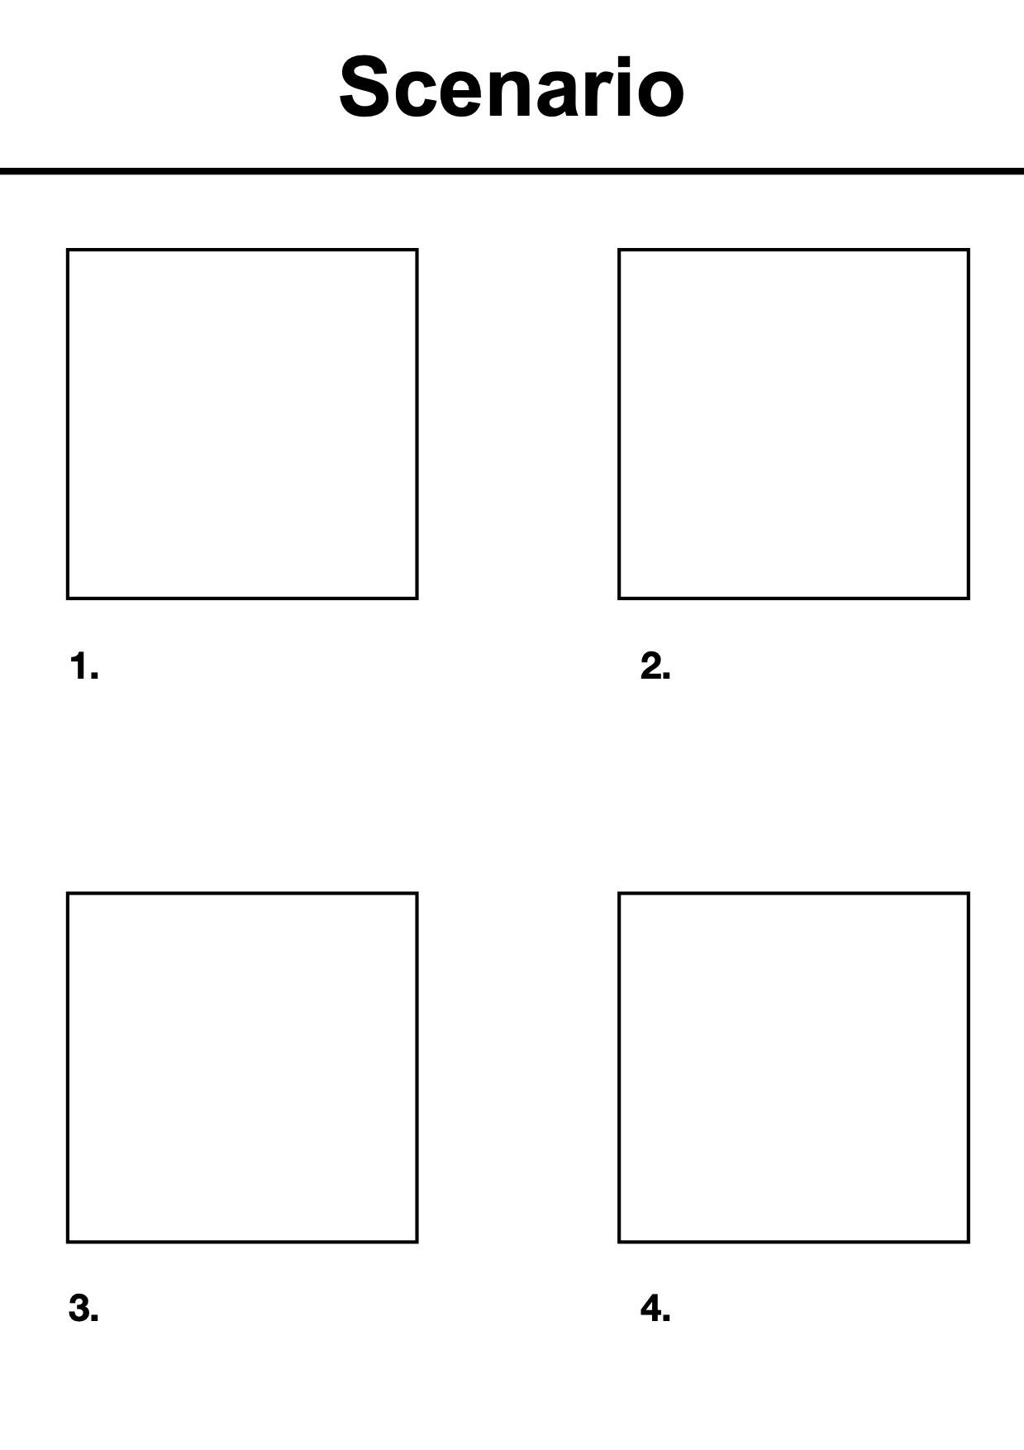
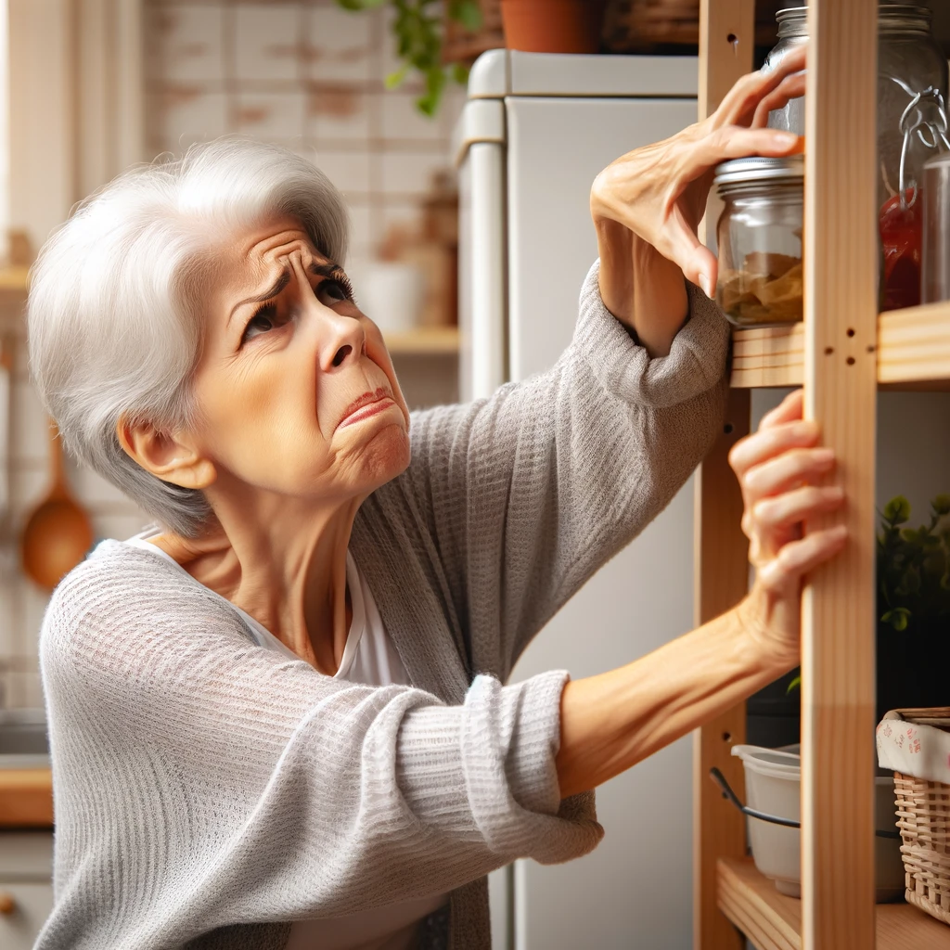
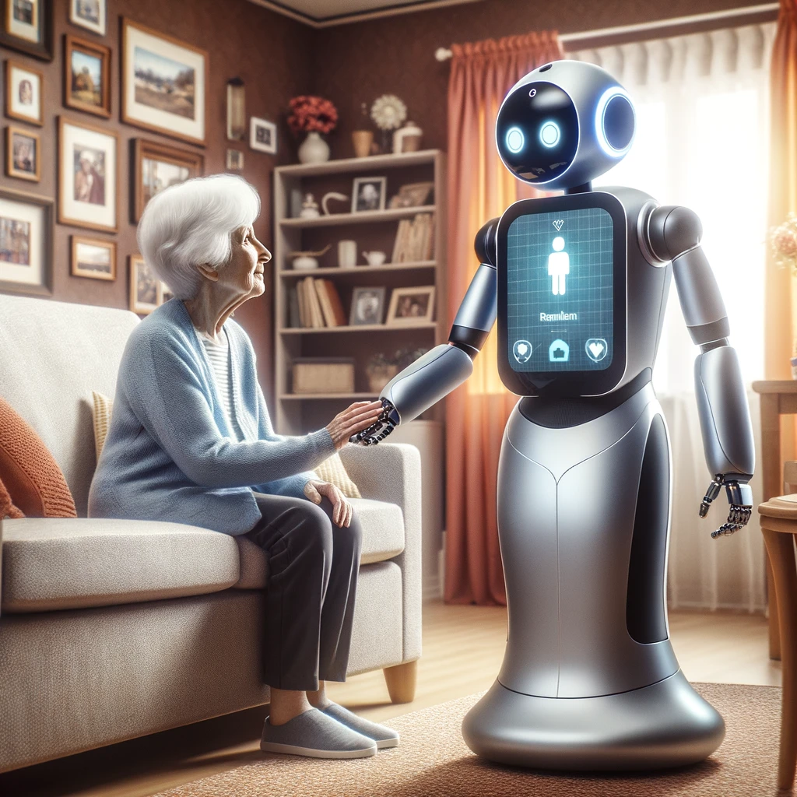
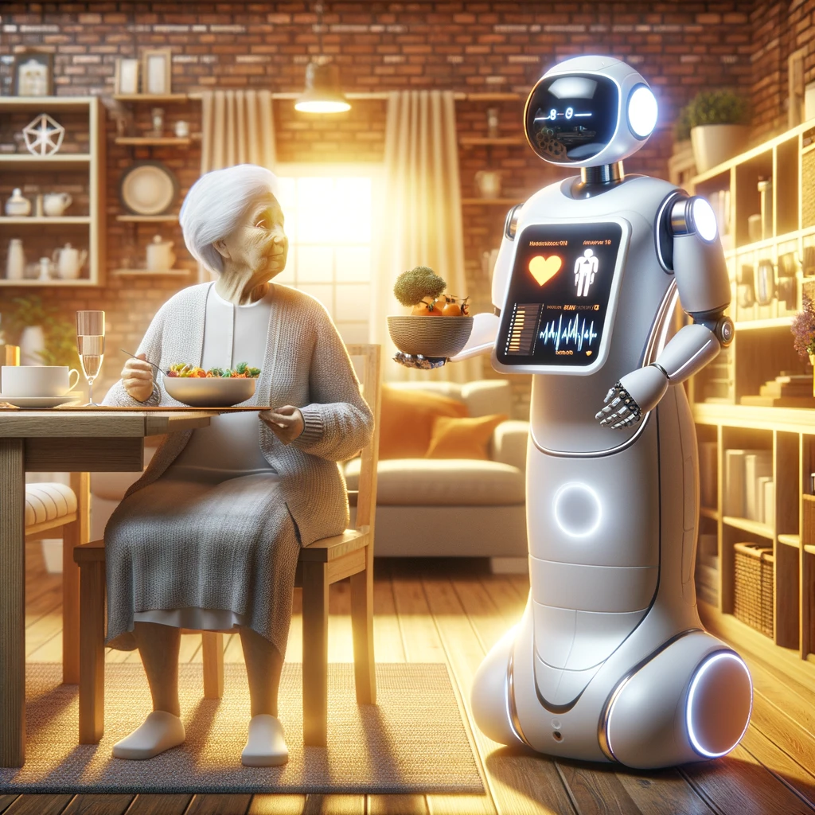

Margaret experiencing frustration as she faces challenges with her daily tasks in the kitchen.
The scene captures the moment when the smart robot "Clara" arrives, offering the elderly woman reminders, physical assistance, and personalized guidance in a comfortable and technology-integrated living environment.
a caring moment where Clara is assisting Margaret with her daily activities, including serving her a meal and monitoring her health conditions
Margaret is able to go about her daily life enjoying her independence and joy

